Slide 1

Prince Avenue Christian School
Rising Senior Night
May 3, 2021

Slide 2
WELCOME
Seth Hathaway
Head of School

Slide 3
Discipleship
Brandt Akin
Director of Spiritual Life

Slide 4
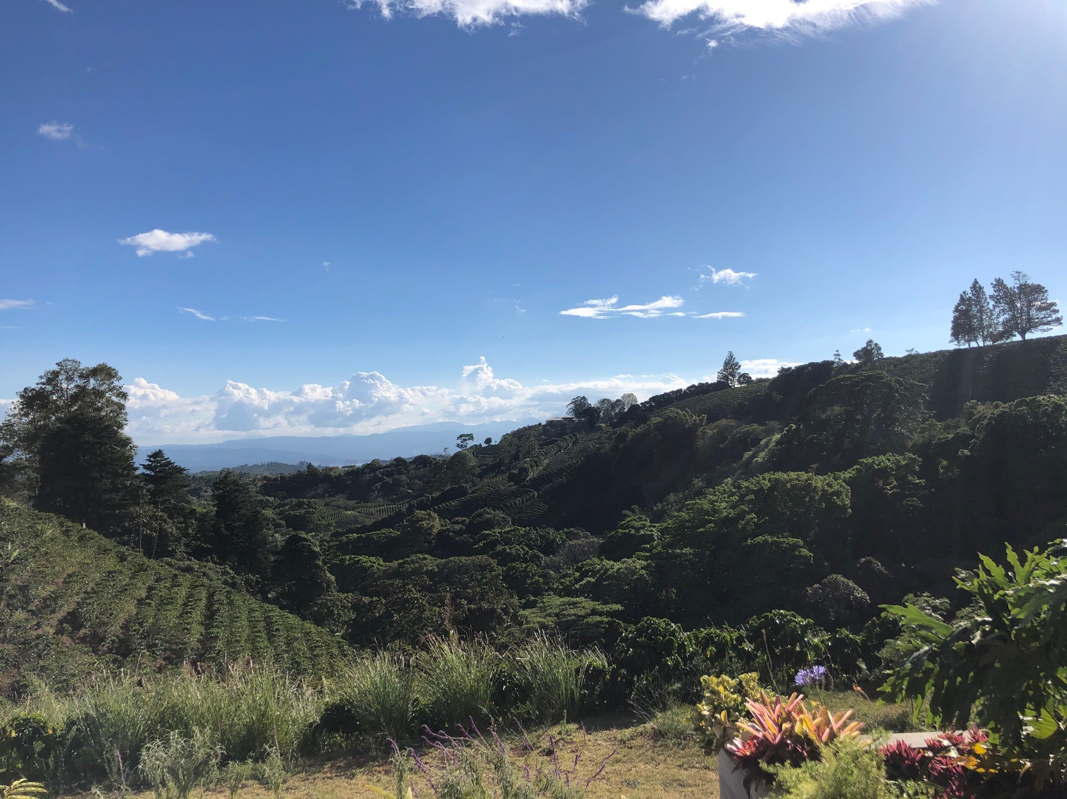
Senior International mission trip
San José, Costa Rica
March 6-11, 2022
Partnership with Joshua Expeditions

Slide 5
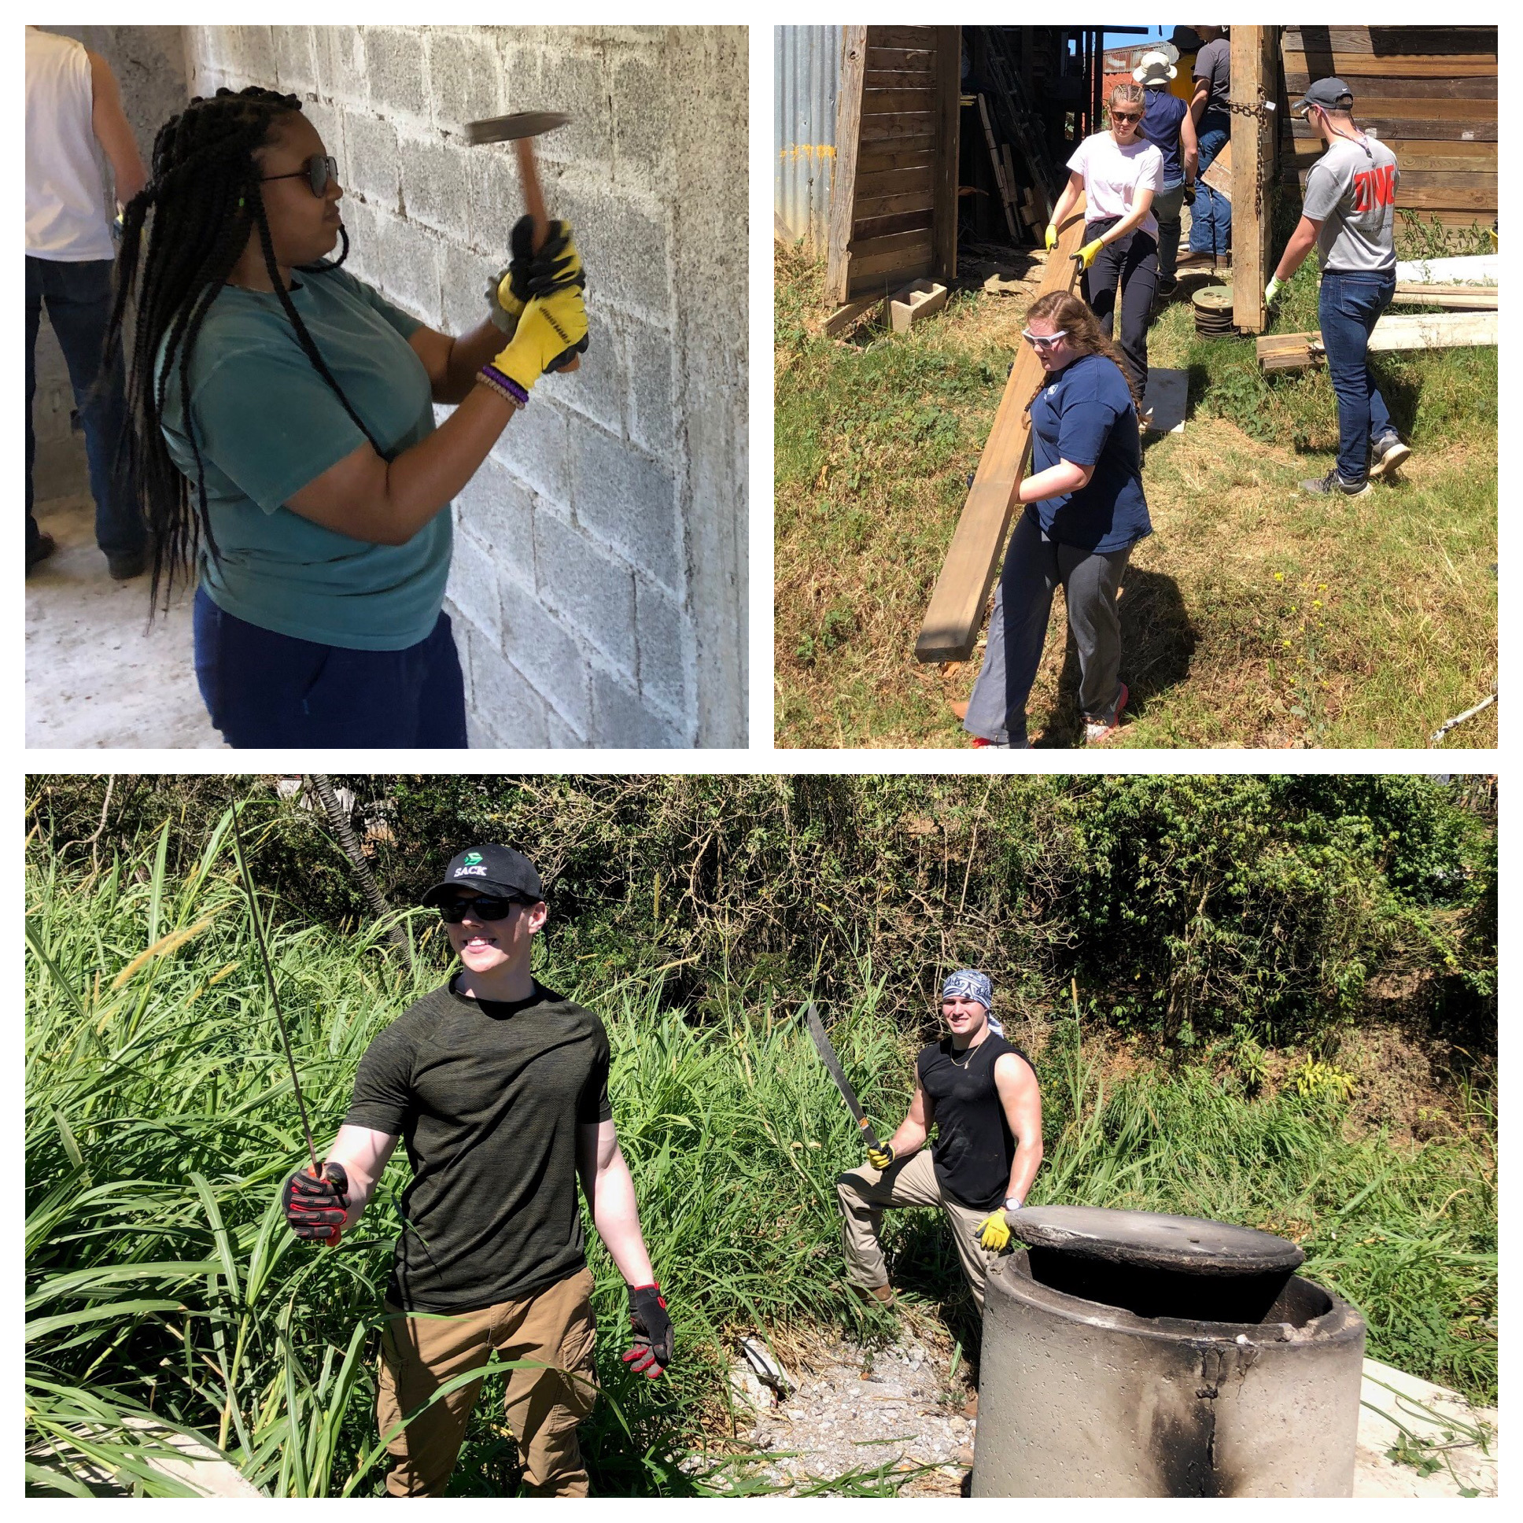
Itinerary
Build and furnish two houses
Outreach with kids in local
community
Tourist Day
(canopy/rafting tour, visit local coffee farm)

Slide 6
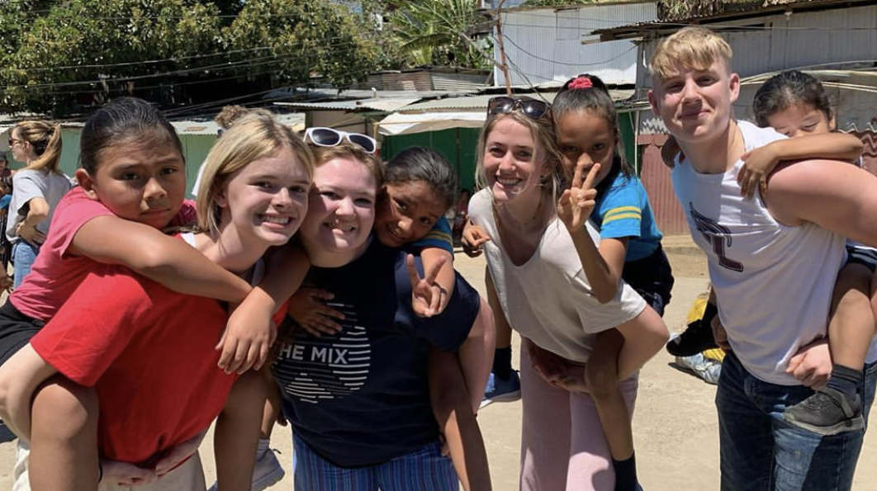
Safety
Centrally located and gated
hotels
Chaperones and responsible
in-country guides
Movement only in groups
Curfew

Slide 7
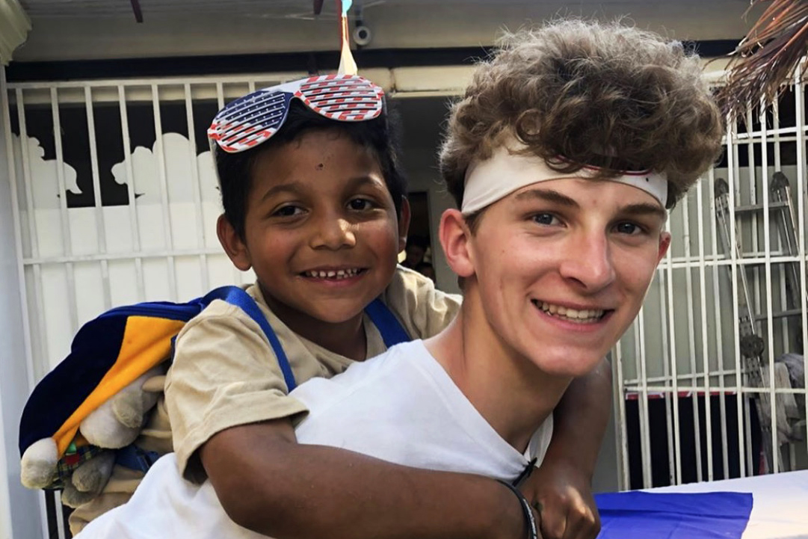
Action items
Register
Passport
Minor Release Form
Traveler’s Pledge

Slide 8
Included in trip costs
Airfare
6 Breakfasts/5 Lunches/6 Dinners
Hotel Accomodations
Private Land Transportation
Full Time Tour Director
Traveler Safety Kit
Travel Protection Insurance
Catamaran Cruise on Day 5

Slide 9
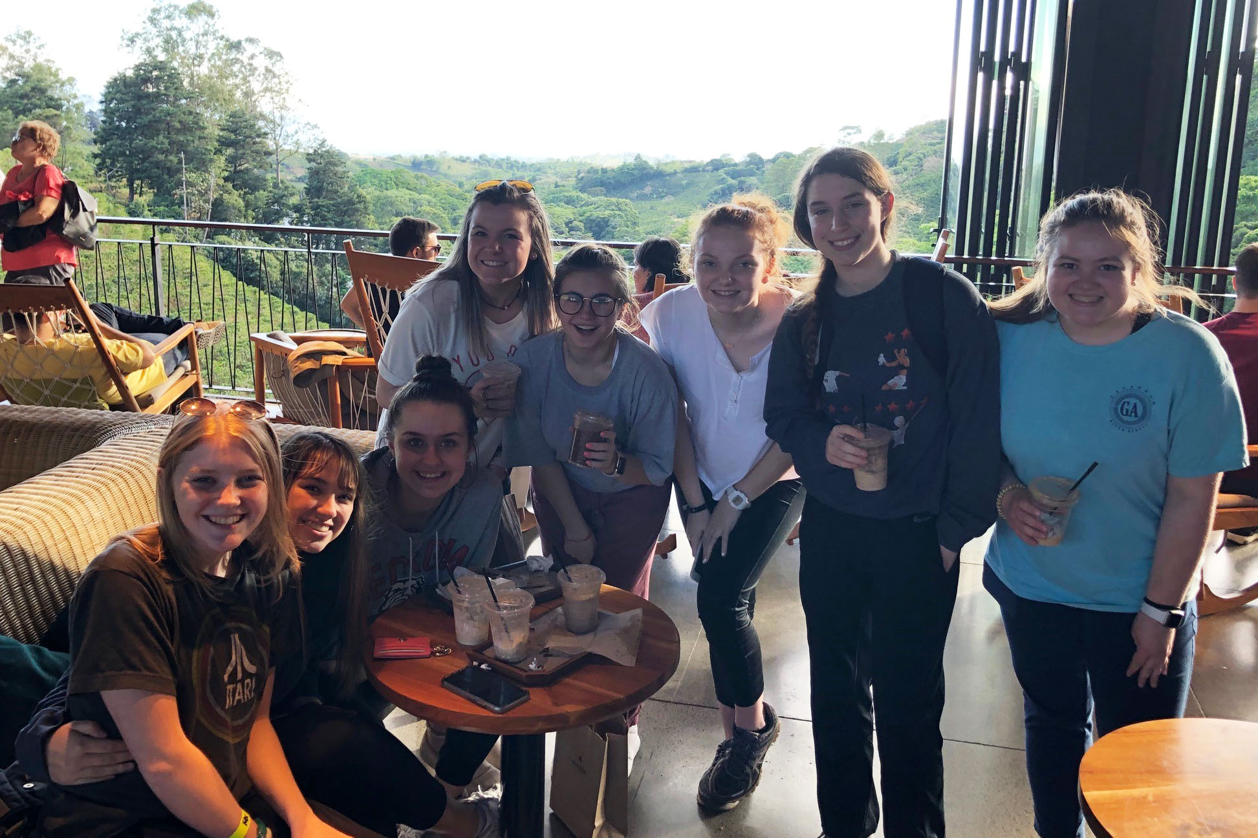
Student cash needs
Souvenirs
Snacks

Slide 10
Mission TRIP COSTS
Lora Morris
Director of Finance

Slide 11
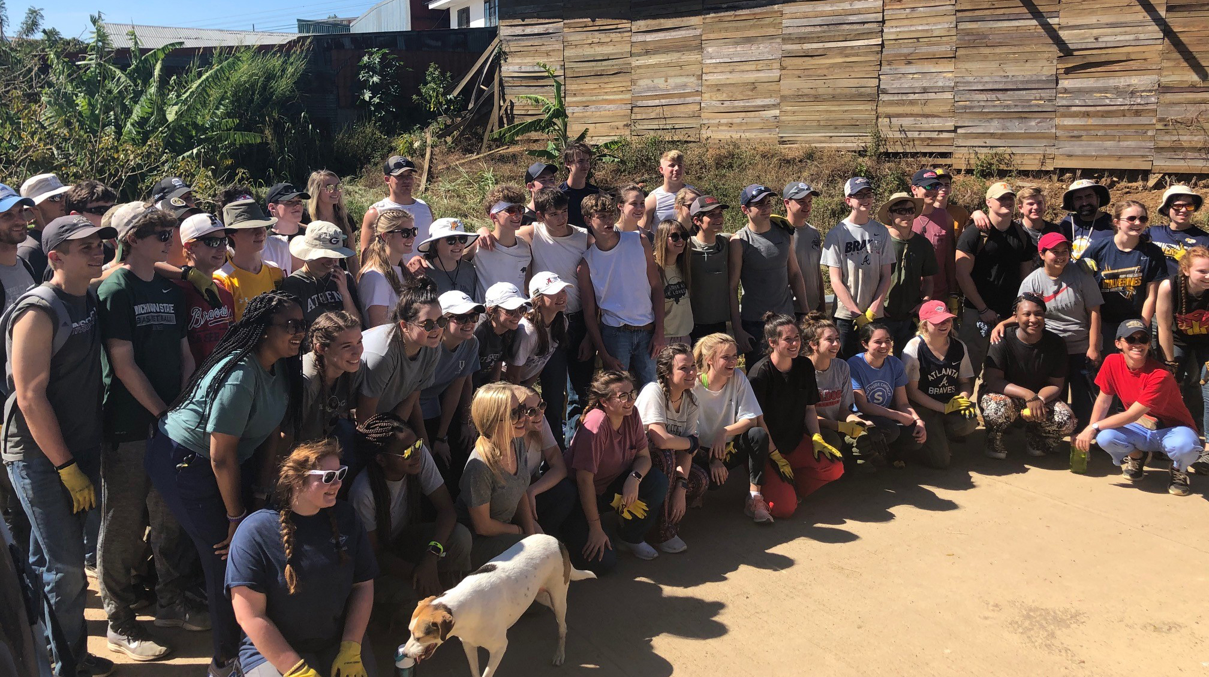
Trip costs
$1,850
$2,000
$1,575
$1,875
$1,900
No Trip planned due to Covid
$1,915 - Includes Incidentals and Trip Insurance

Slide 12
Incidentals paid by pacs
(Partially funded by deposit)
All Construction Materials ($8,000 value)
Grocery shopping for the family's new home
Pre-flight Covid test in Costa Rica ($50 per person)
Checked Baggage at Airport
Bus rides
Bus Drivers
Tips
Local guides/Translator
Emergencies

Slide 13
$99.65 trip insurance details:
Medical Coverage for injury or sickness
Travel costs to return home early due to an unexpected emergency
Lost Luggage expenses
Trip Delay expenses
Trip Interruption/Cancellatiom - 100% refund
Cancel for any Reason - 50% refund
Covid Peace of Mind - additional 40% refund

Slide 14
timeline
Trip must be paid in full by January 3, 2022

Slide 15
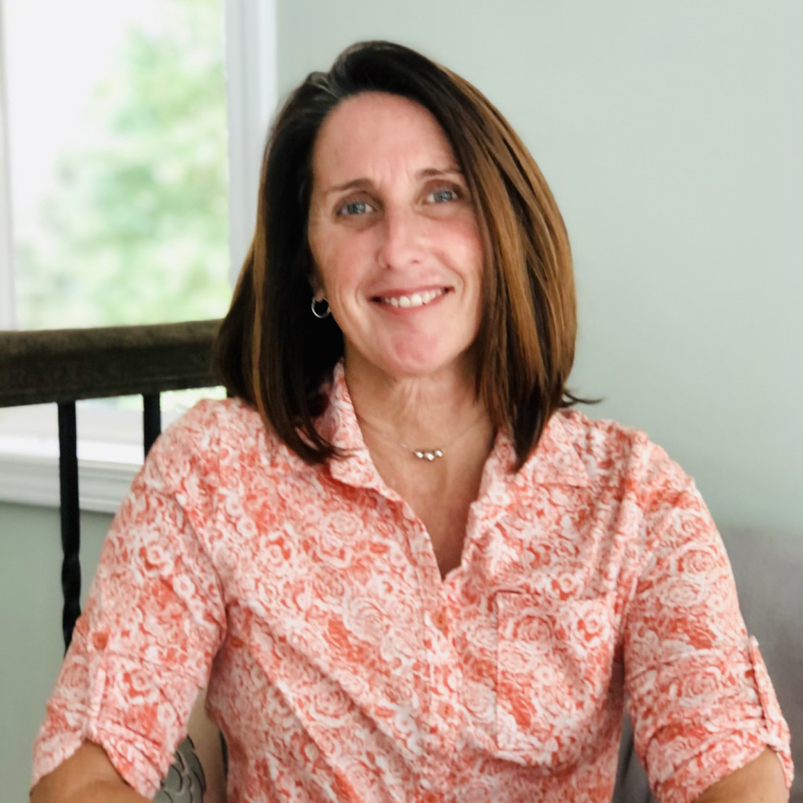
Contact:
Lora Morris, Director of Finance
lora.morris@princeave.org
678-726-2311

Slide 16
SENIOR CLASS PRIVILEGES
Daniel Head
High School Principal

Slide 17
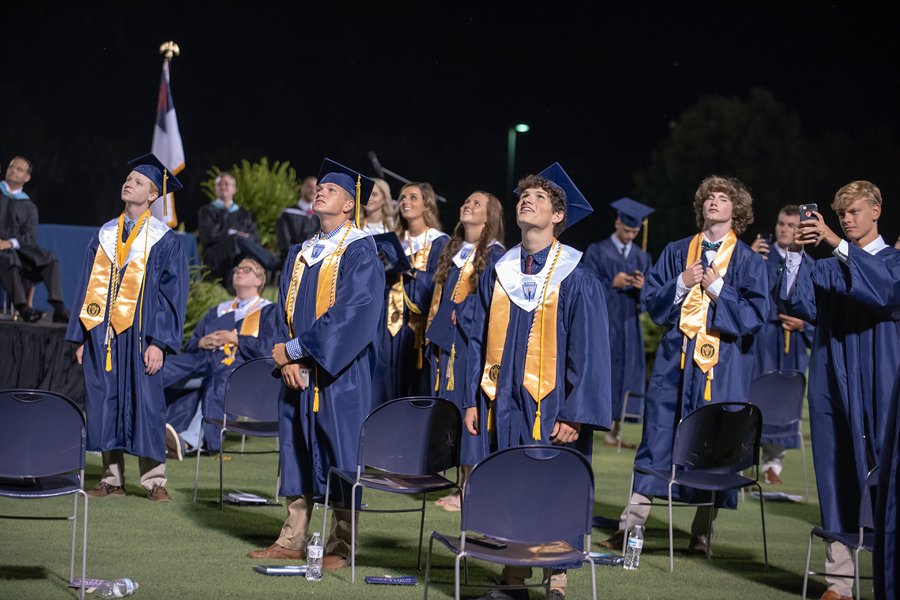
Graduation ceremony for the Class of 2021
All current juniors are highly encouraged to
attend Prince’s Graduation
Saturday, May 15 at 7:00 pm ~ Brad Akins Field
Juniors sit in reserved seating together
Please dress appropriately
  Boys in khakis with collared shirt
  Girls in dresses (not pant suits). Please dress conservatively with skirts no more than 4 inches from the knee.

Slide 18
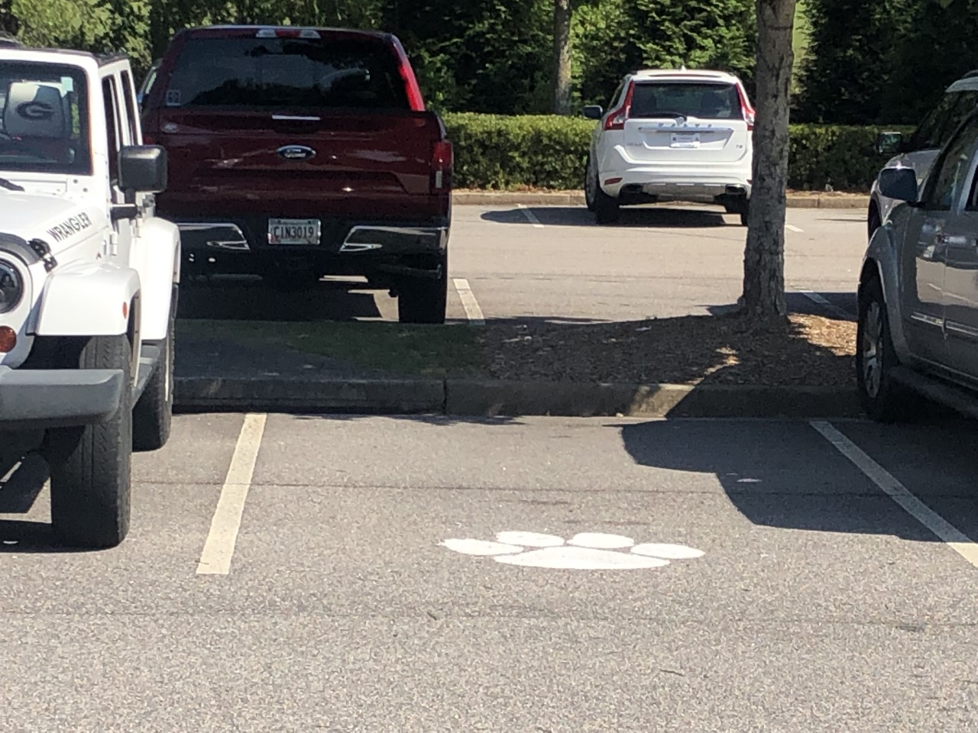
Reserved parking spots
Seniors will be able to reserve and paint a
parking spot in the student parking lot.
Students here tonight get first choice of parking spot.
Parking lot painting will be organized by the senior class student government during the summer OR when we return to school in August.
It is best to paint your spot. If you do not, then non-senior drivers think the spot is open and will park there.

Slide 19
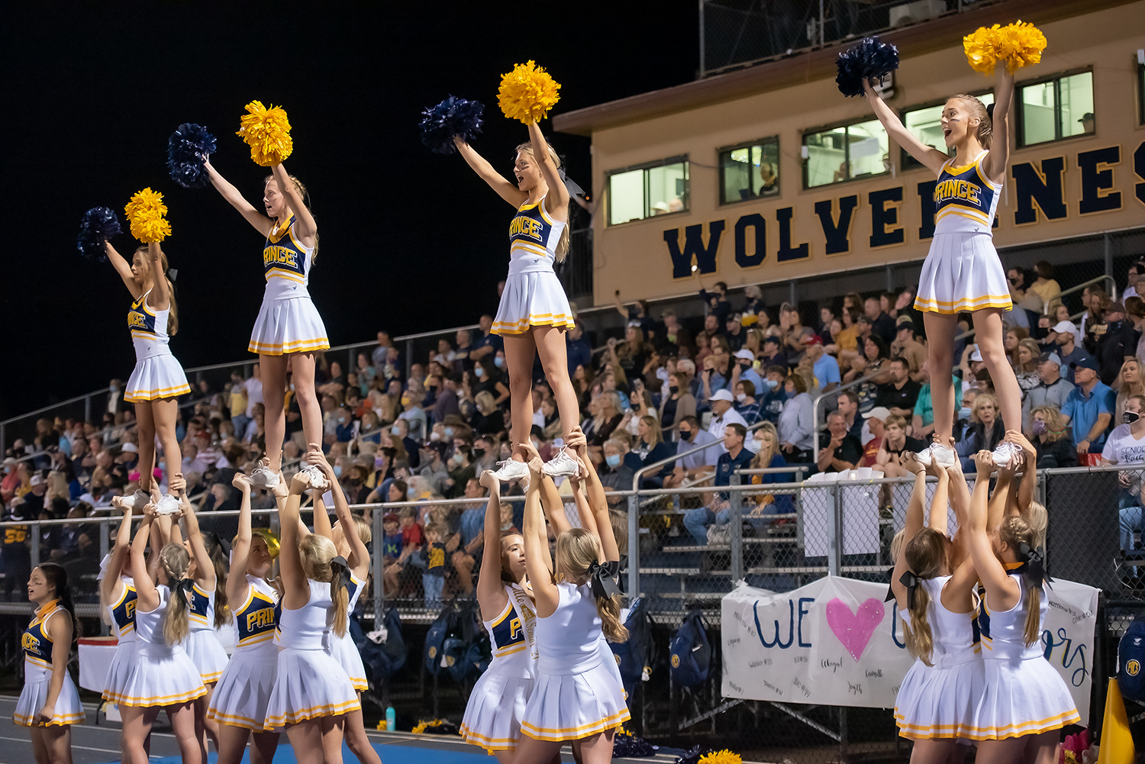
Senior Tailgating for home football games
Identify a teacher to sponsor/supervise
and coordinate with high school office.
Students are responsible for providing food and drinks.
The school can provide tables and trashcans.
Students are responsible for cleaning up the tailgate
area during halftime.

Slide 20
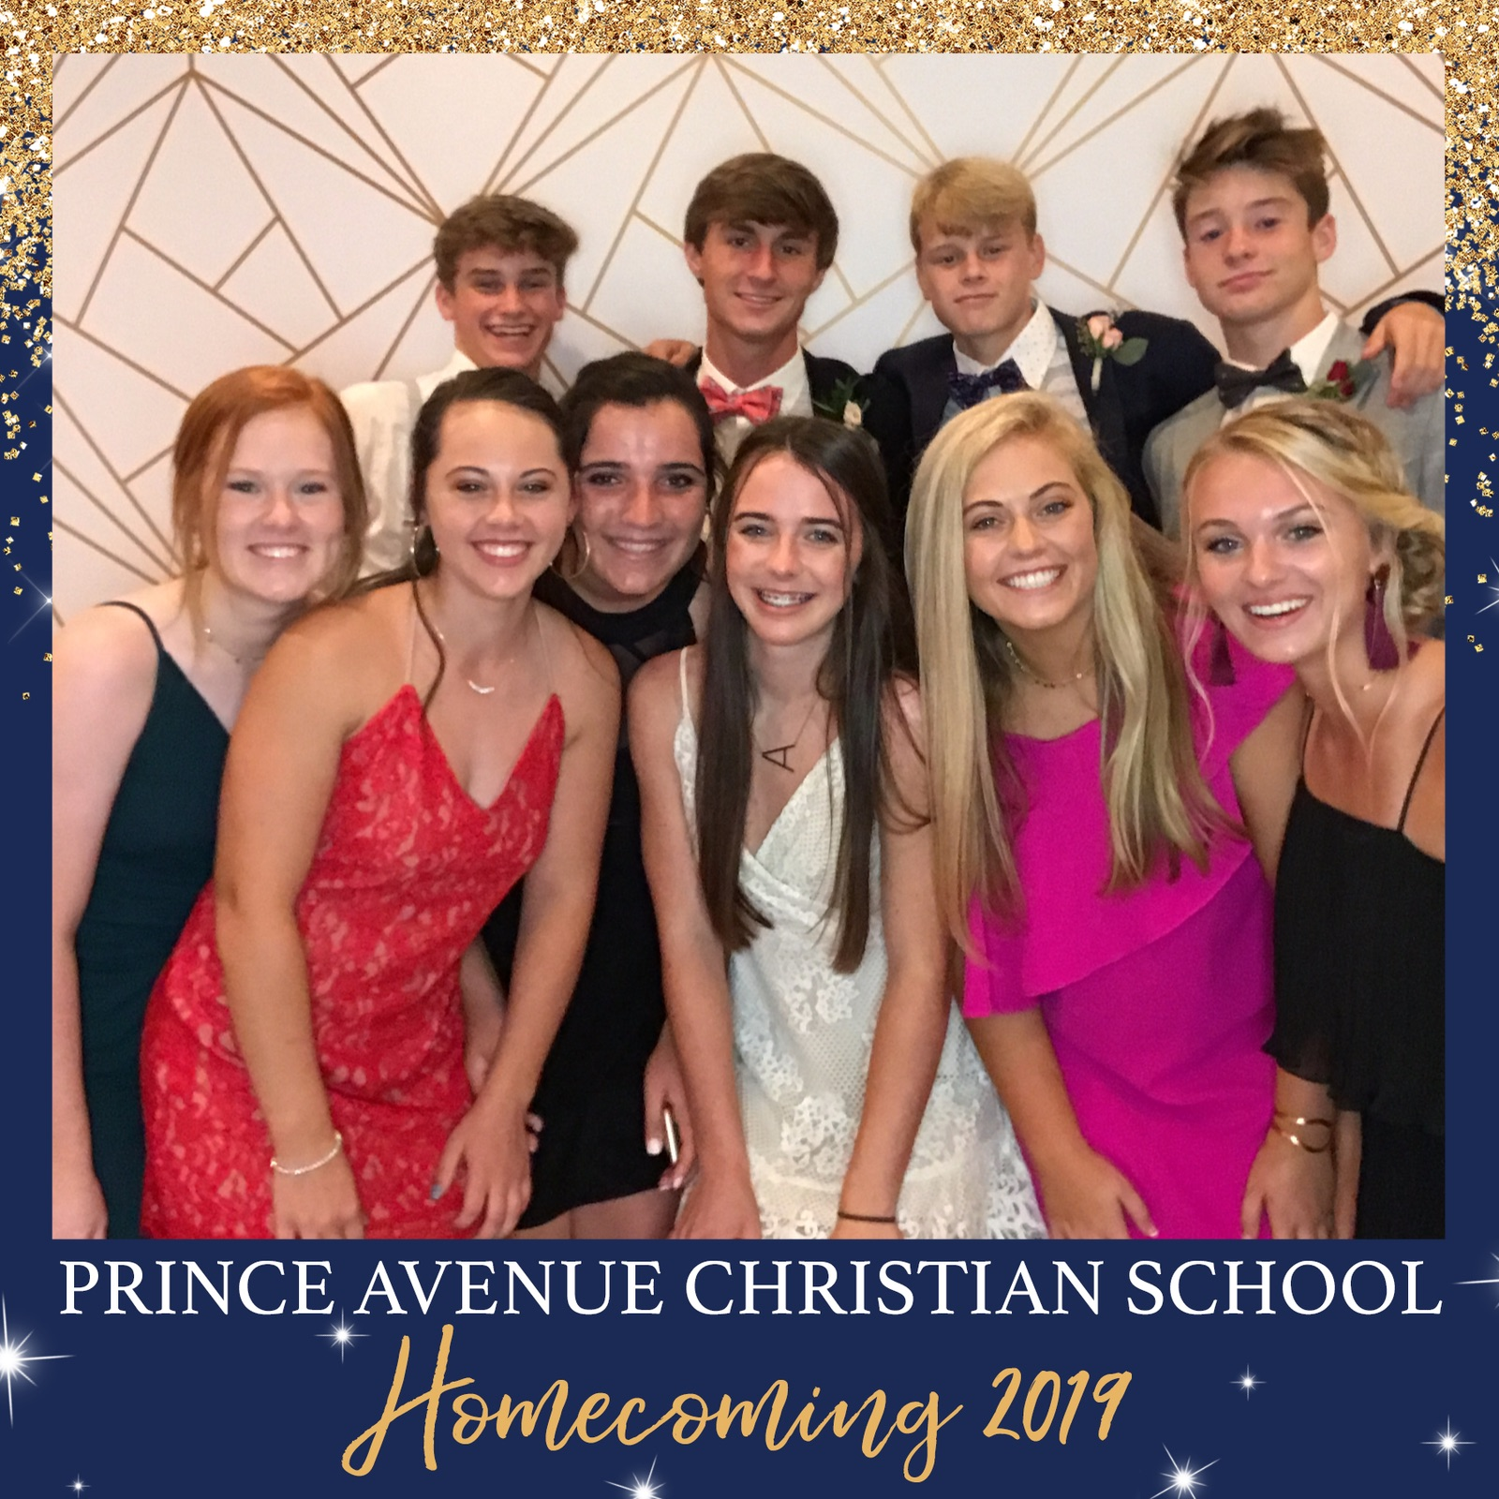
Homecoming dance
Saturday, October 23, 2021
A traditional Homecoming Dance
experience for grades 9-12

Slide 21
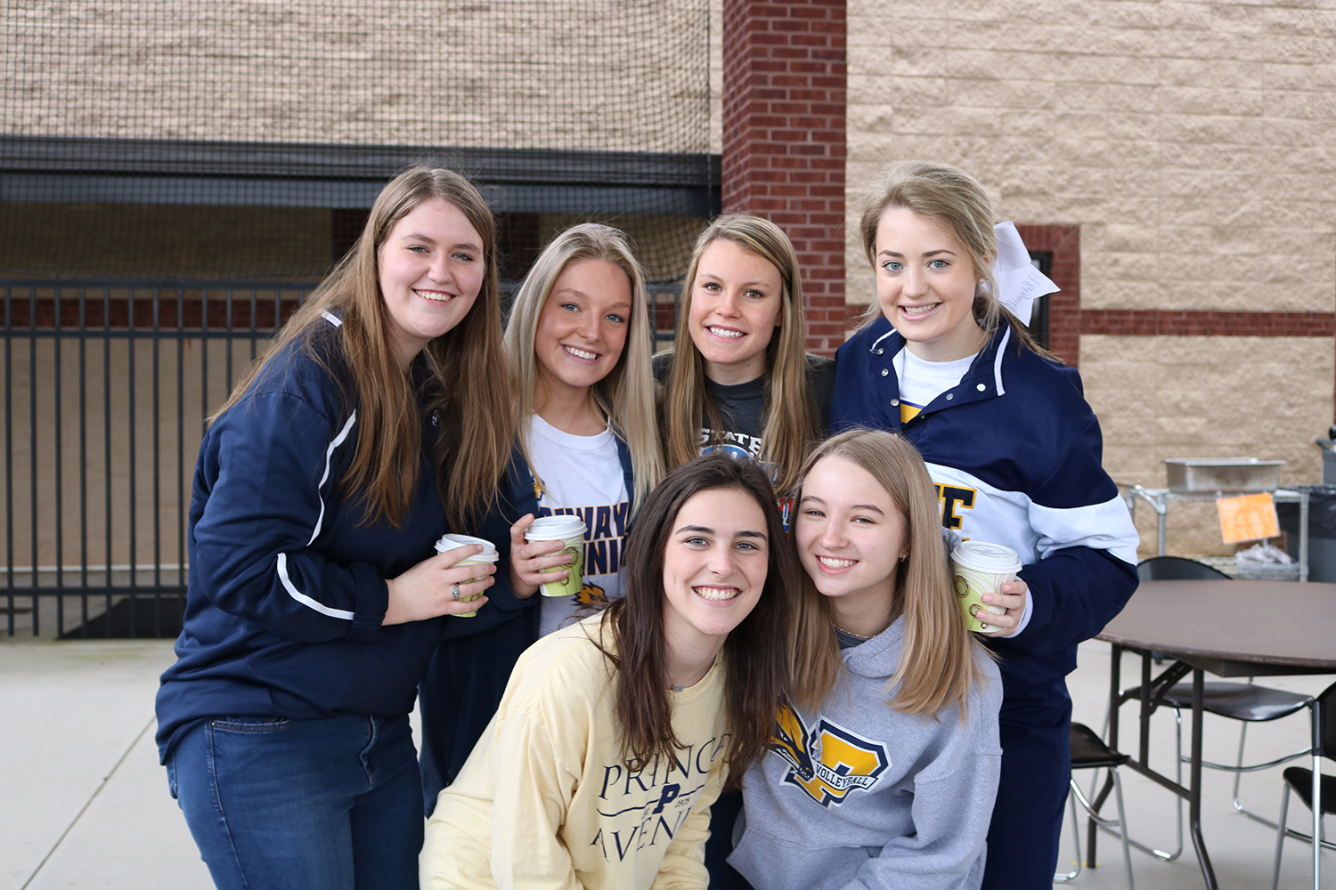
Senior off-campus lunch
This is a second semester privilege granted if the class of 2022 earns it through their first semester performance.

Slide 22
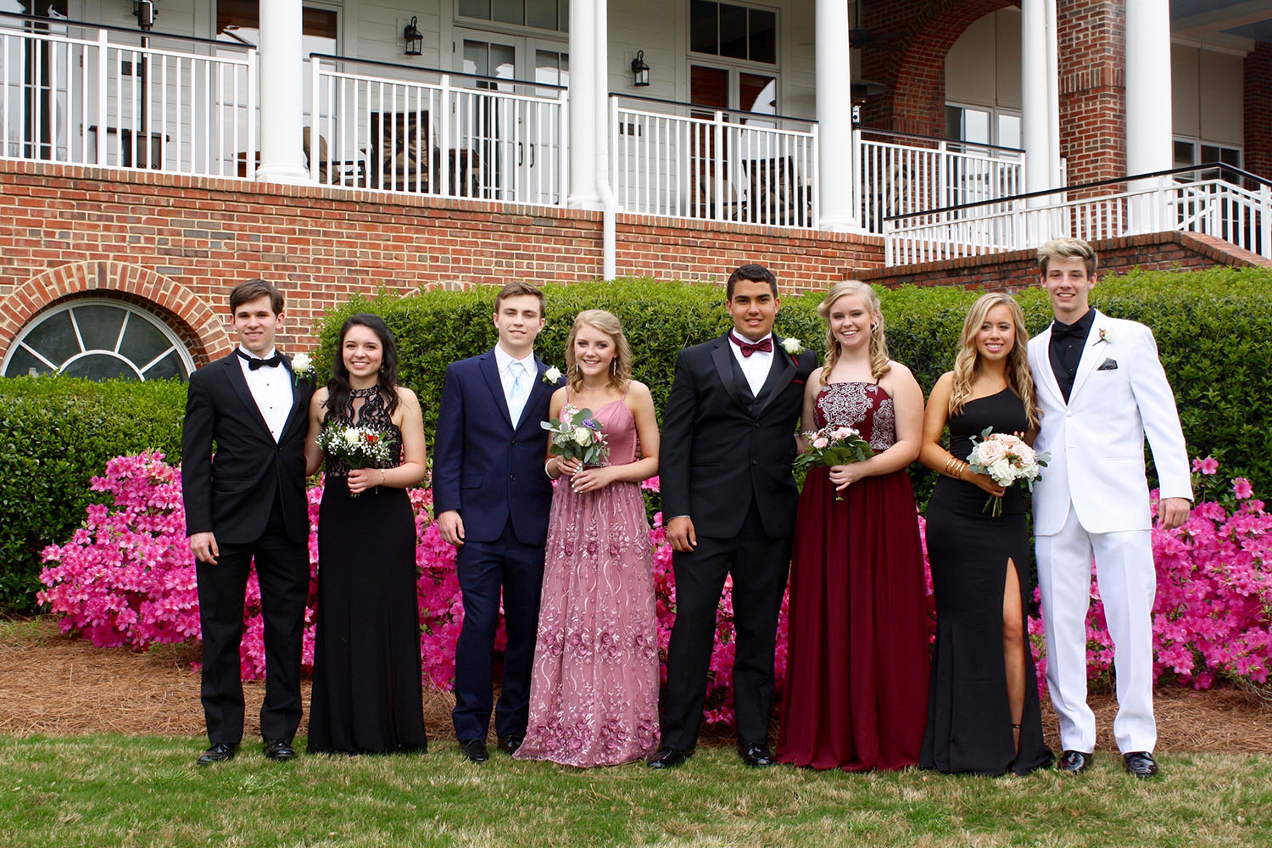
Junior/senior banquet
A spring event for the classes
2022 & 2023 and their guests
(only)
No underclassmen unless they
are a guest of an upperclassman
April 2022

Slide 23
guidance
Lisa Ricketts
Guidance Counselor

Slide 24
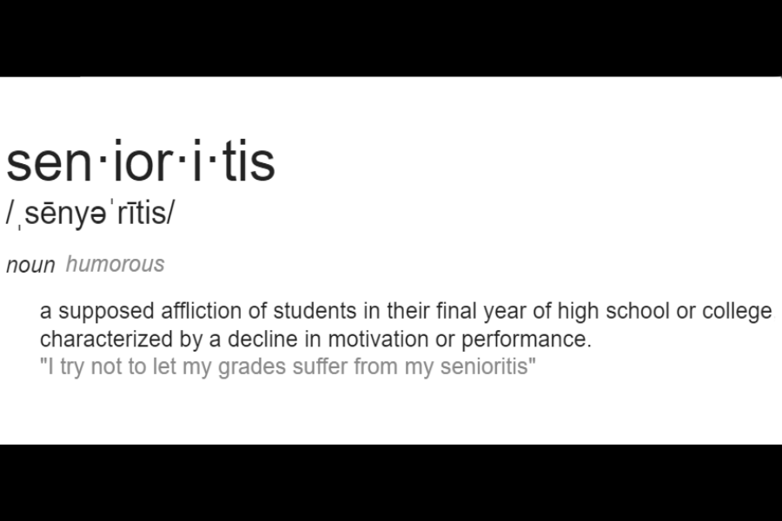
Senior year = personal responsibility
Seniors should take responsibility and drive the train, parents in next seat praying, checking, guiding, encouraging!
Parent tip…do NOT fill out college apps or write essays!!! You are setting them up for failure…How will your child survive in college?

Slide 25

What comes next… ?
  Fall of 2021 - Detailed “College Planning Meeting” that Seniors & parents MUST attend…Many, many details to discuss with the College Planning Process.
  Fall of 2021 - Meeting with Seniors in small class settings to explain how this process works on a day-to-day basis.

Slide 26
COLLEGE APPLICATIONS
WHEN?...
Check college applications in summer to see if they are ready and if essays are changing. Some colleges tweak their apps and essay questions in summer. If they are ready, you can begin.
Earliest application deadlines are normally OCTOBER (EA, top notch grades, rigor, test scores, accepted, deferred, denied)
Next common deadline is MID-JANUARY (RD, accepted or denied)
Other…ROLLING DEADLINES (can apply until May, accepted or denied)

Slide 27
fine arts
LaMurl Morris
Director of Fine Arts

Slide 28
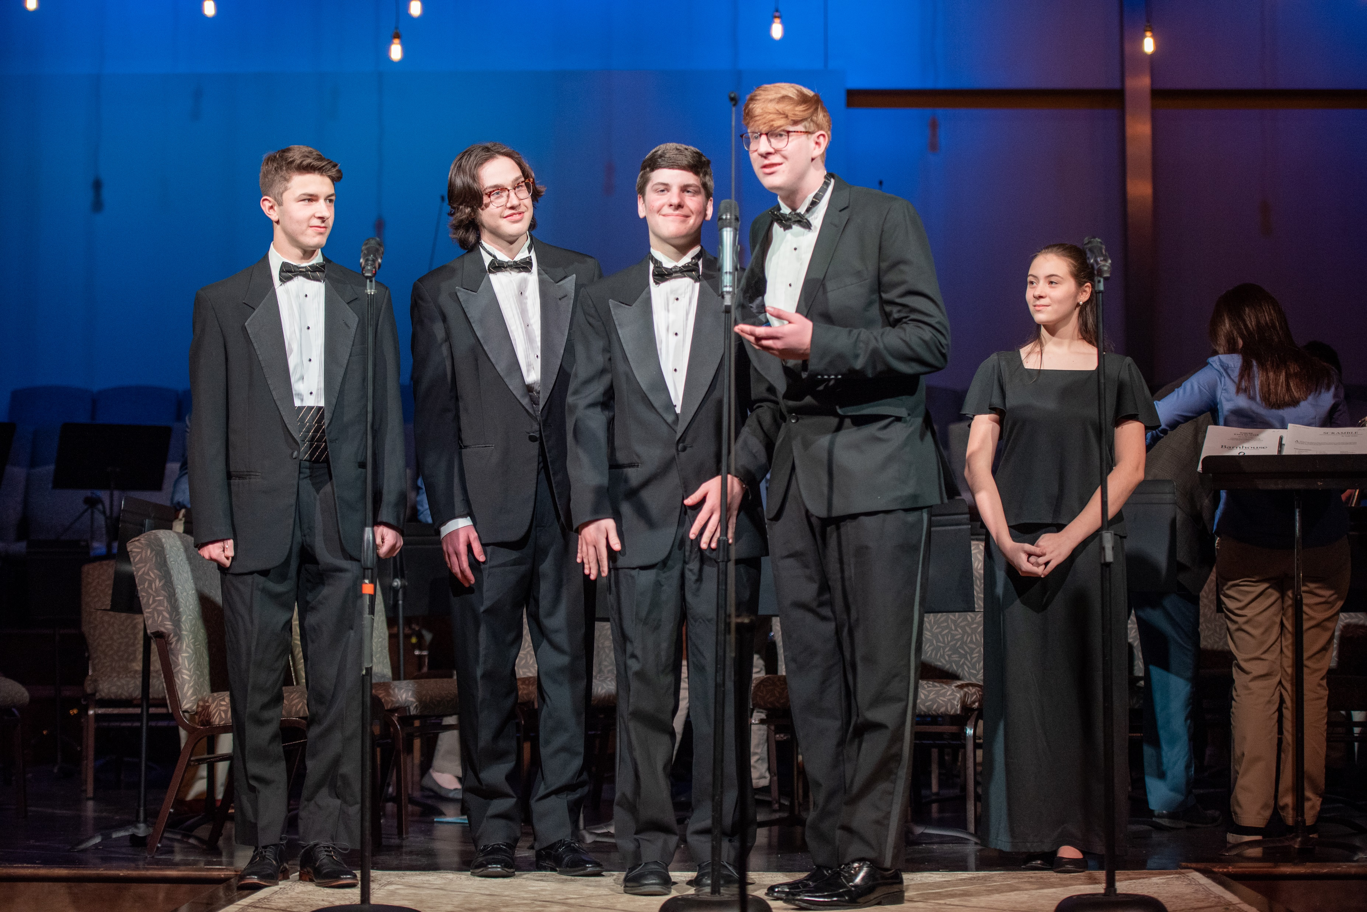
Fine Arts opportunities for 2021-2022
Auditions for Singin’ in the Rain and/or
The Sound of Music
Join the Improvables!

Slide 29
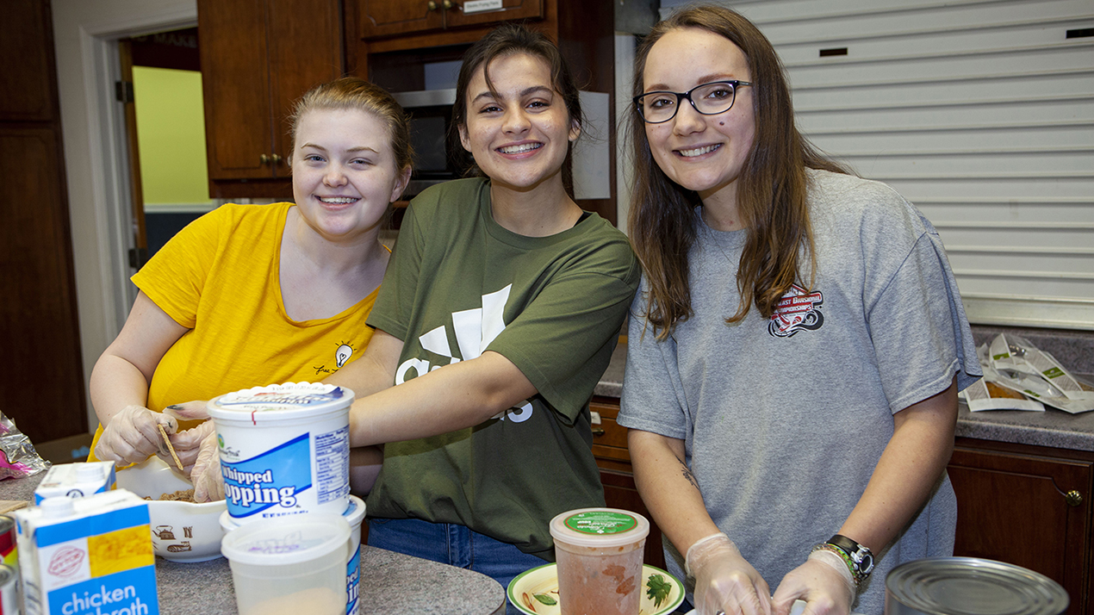
The importance of Volunteer service hours
20 hours required for senior year
Important for college and
scholarship applications
Volunteer Service Hours Form
on the PACS website

Slide 30
Athletics
Richard Ricketts
Athletic Director

Slide 31
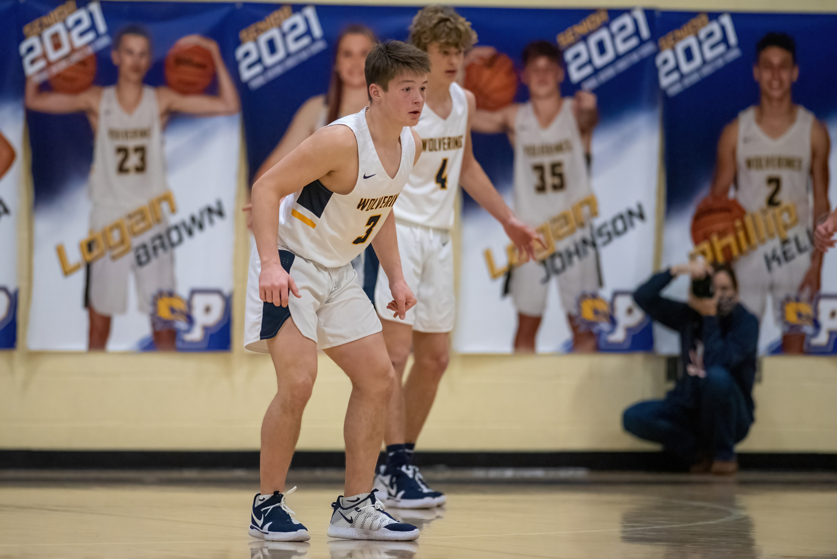
Senior Fall sports picture day & senior banners
Tuesday, July 27 – 5:00 pm
Individual pictures
Separate day from team pictures
Banners are ordered through athletic department & paid
by parents

Slide 32

Athletic signings
Contact Coach Ricketts as soon
as you have made a decision.
The athletic department will
handle all details of the signing day.

Slide 33
student life & ALUMNI RELATIONS
Kim Brannon
Development Office

Slide 34
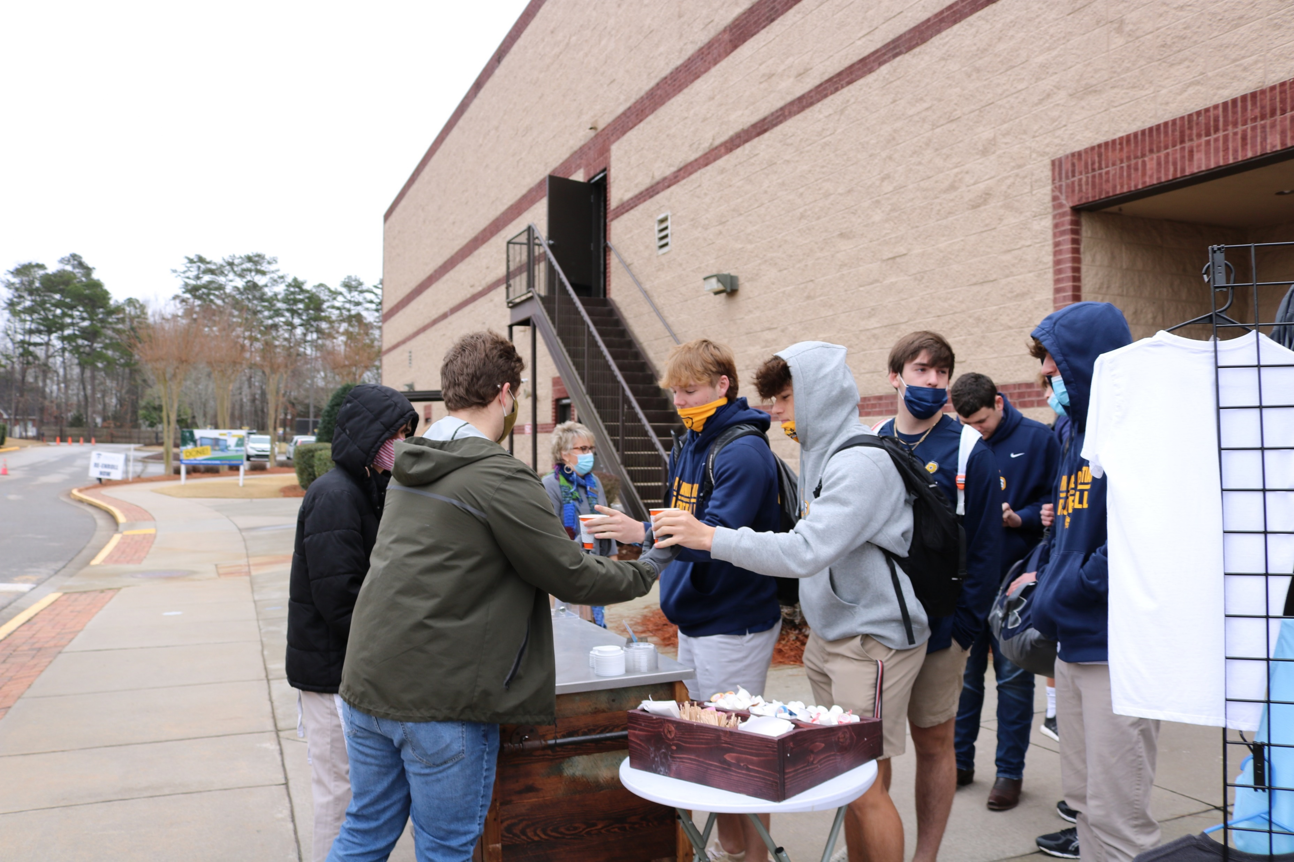
Special events
We work to make things special and fun!
We provide senior class treats from development.
The senior class picks out and decorates the school’s Christmas tree.
Senior Last Walk: last day of school
Senior Supper: The night before graduation ~ senior class video & gift from school

Slide 35
senior portraits
Amy Frierson
Marketing Director

Slide 36
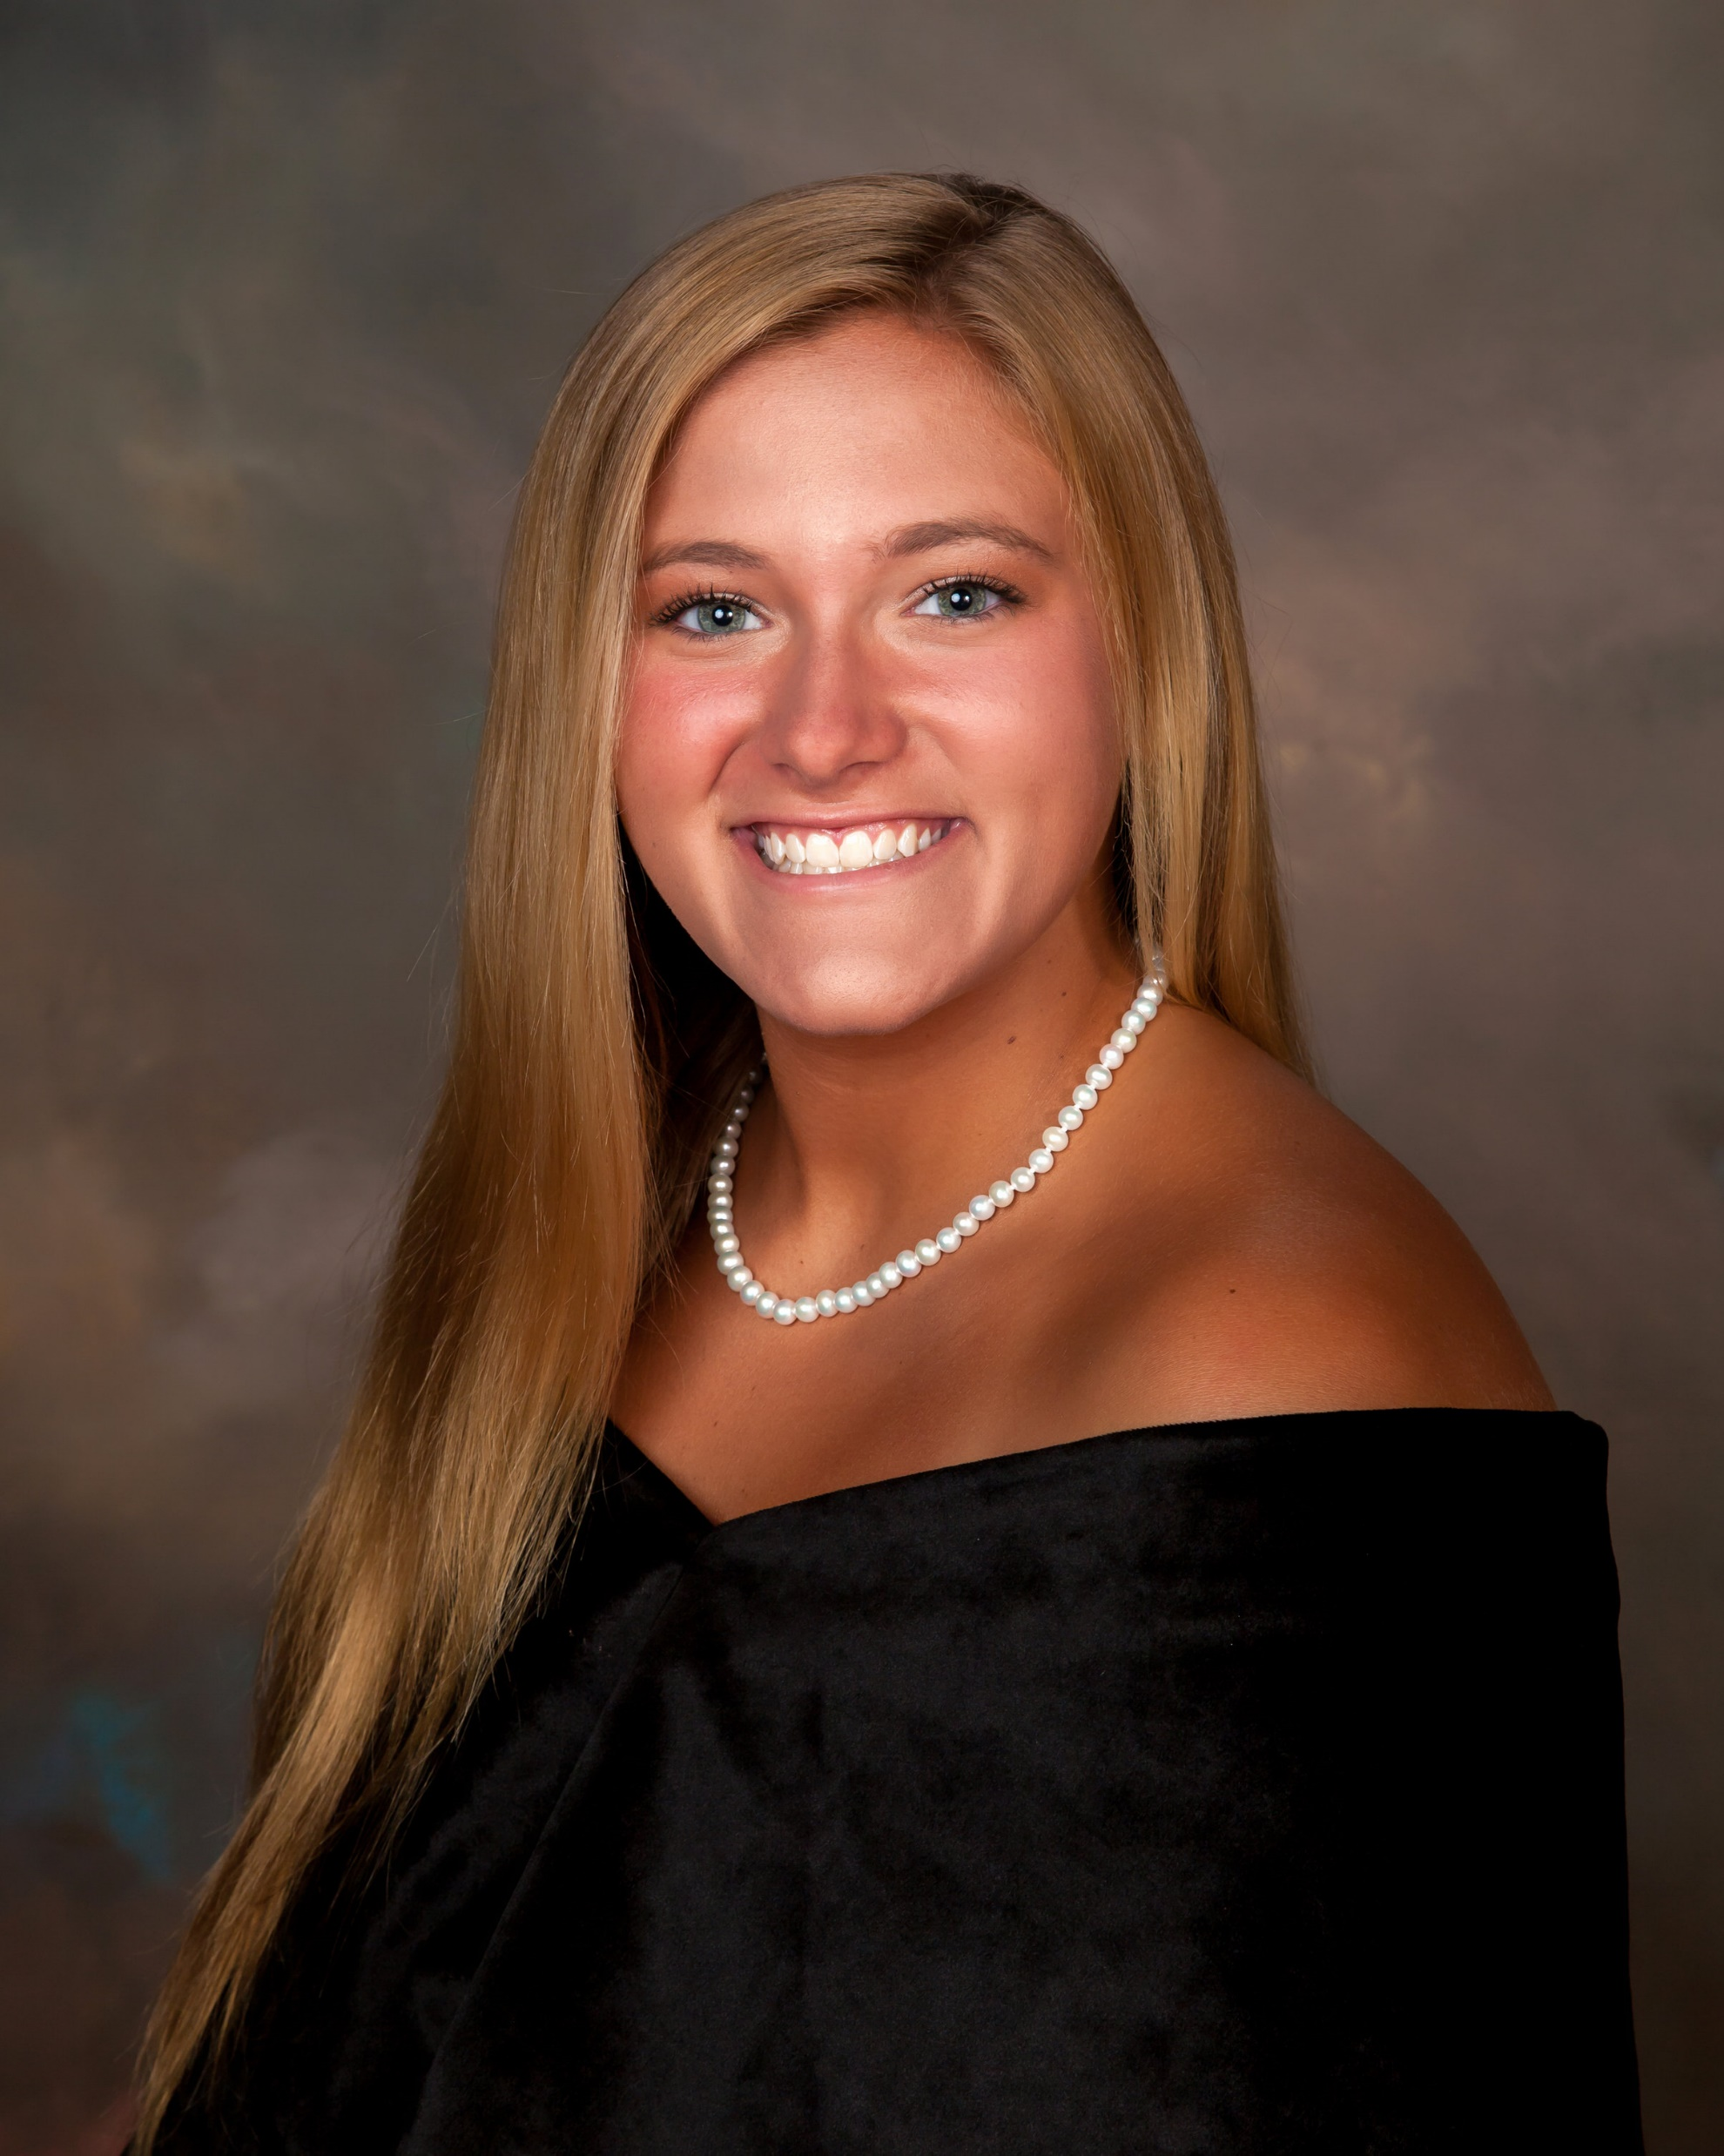
Senior portraits
School Photographer: Watermark Photography
  Formal (drape or tux)
  1 Casual (used in yearbook & for school publications)
  $50.00 Sitting Fee – (cash, check, credit card, or Venmo)
Primary Date Monday or Tuesday, May 24 or 25
  Hadden Estate – Watkinsville, GA
  Plan for 2 hours
Reserve a time through the link provided in email

Slide 37
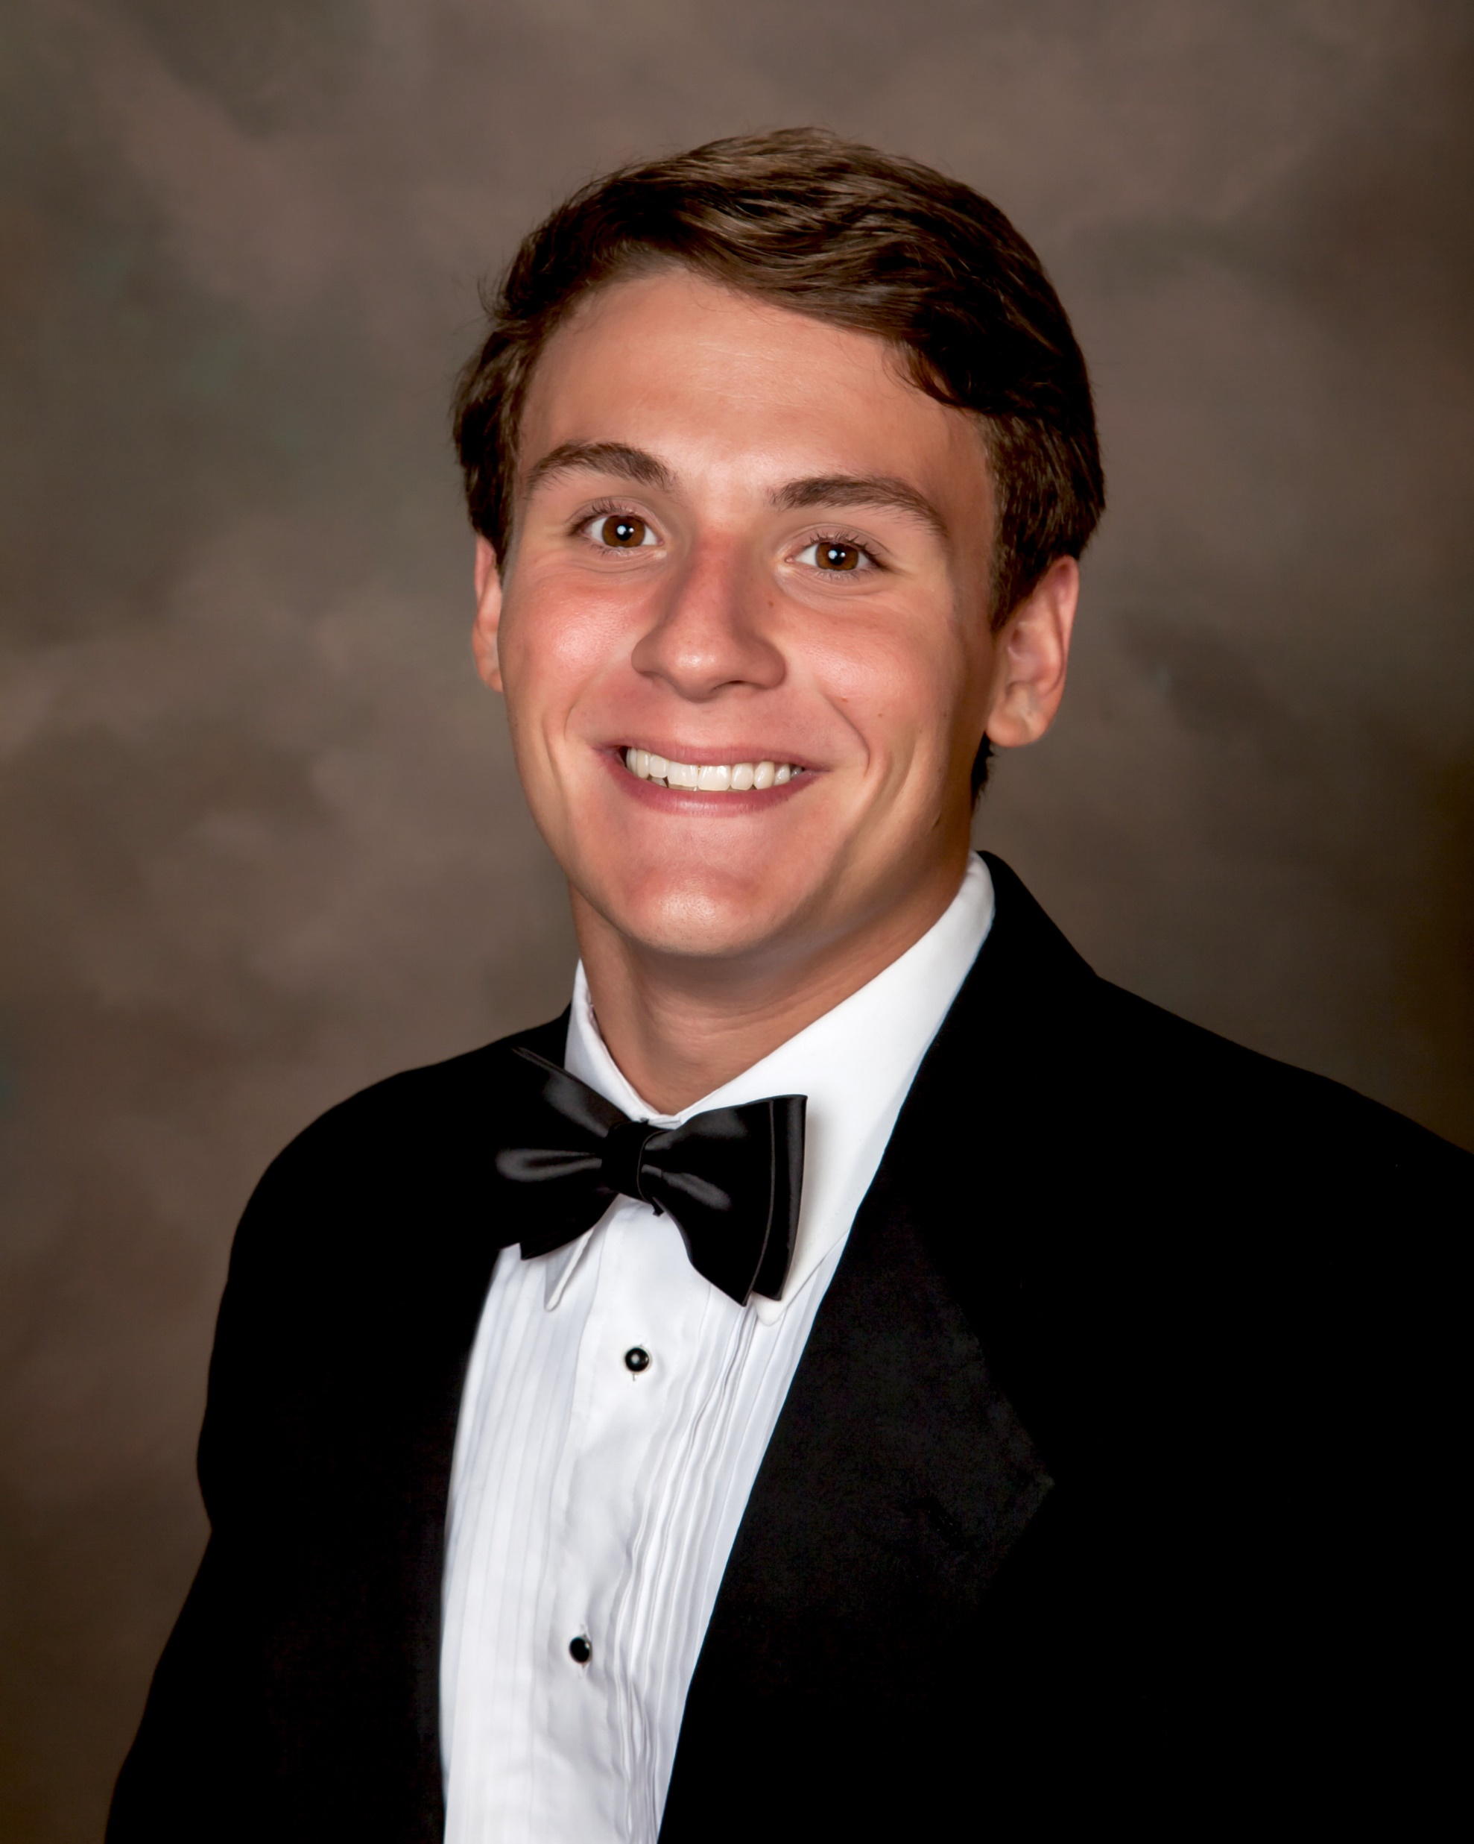
Senior portraits
Alternate Date: Friday, July 23 at PABC
Sign-Up link will be sent soon
Final Date: School Picture Day in
September (TBD)
For ALL Senior Portraits, you will be provided
options to purchase digital rights or hard copy
packages through Watermark Photography.

Slide 38
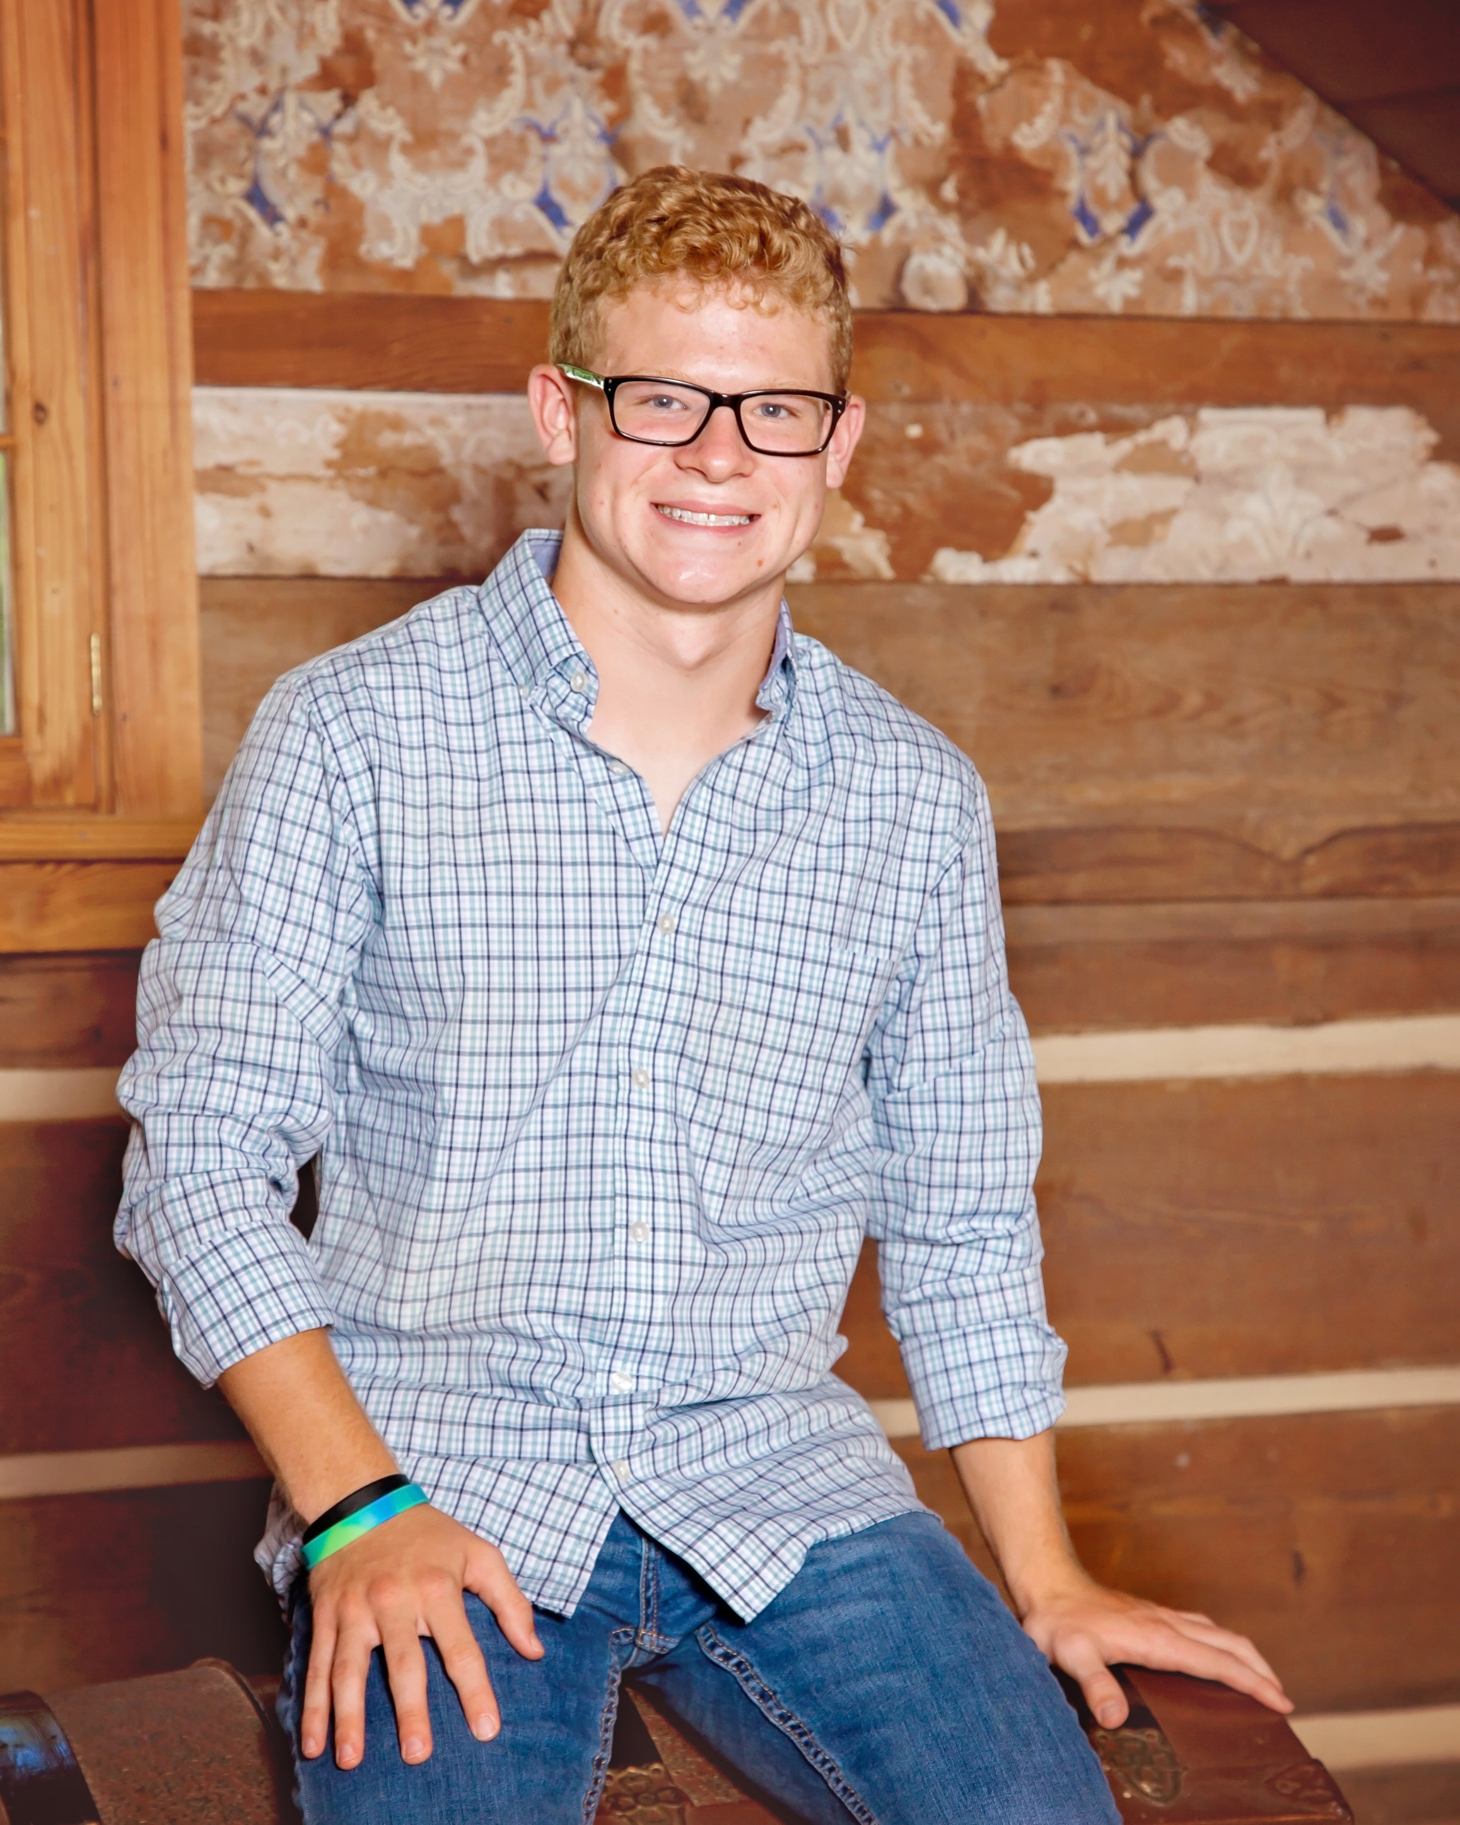
Senior portraits
What if I want more casual picture
options?
  Free to schedule additional
  mini-sessions with
  Watermark Photography OR . . .
  Free to schedule with a photographer of
  your own choosing
  Remember – the formal and 1 casual MUST
  be taken by Watermark Photography

Slide 39
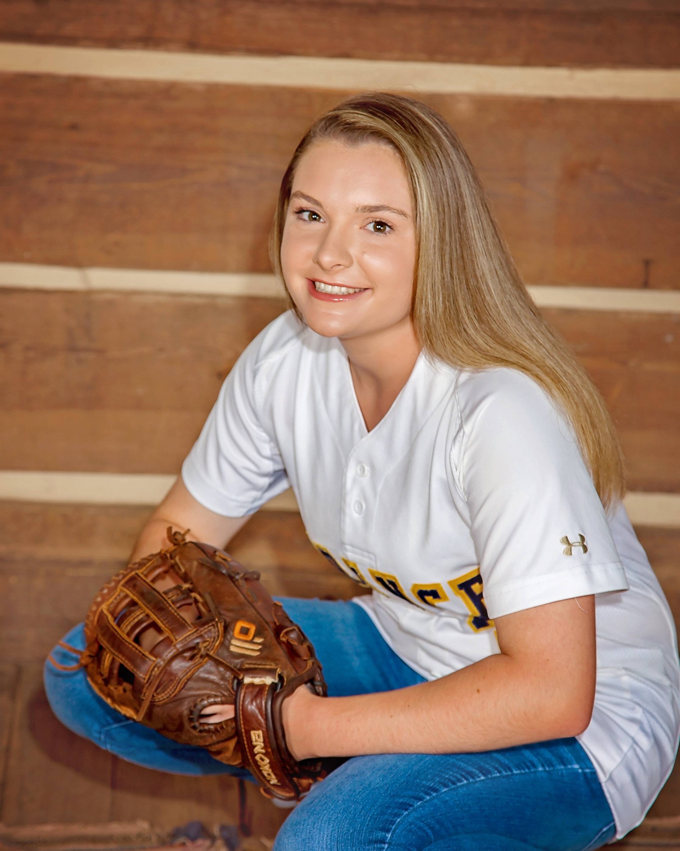
Senior portraits
Dress Code for Casual Pictures with
Watermark
  The “too” rule – not too short or too tight
  No bare midriffs
  No undergarments showing
  Girls must have sleeves/straps on shirts –
  no tube tops
  Boys must have haircut and be clean shaven

Slide 40
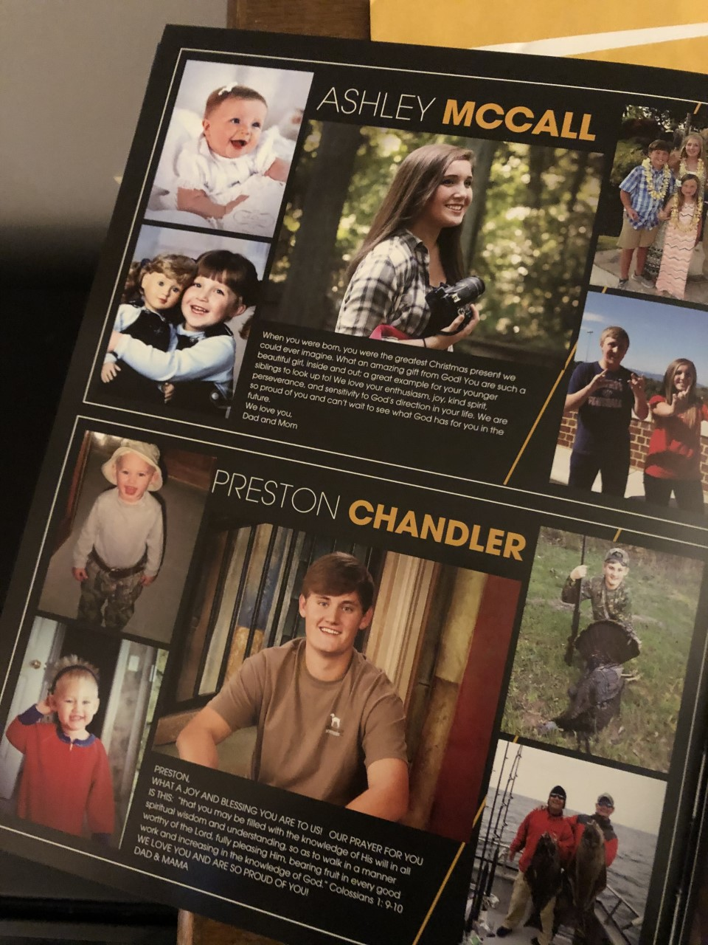
communications
Other items to keep in mind related to media:
It is helpful to think ahead and have digital scans
  Senior Yearbook Ad
    Fall Semester – Sold by PACS Yearbook
    Full, half, or quarter page
    Provided link to design your ad
  Senior Montage Video
    Spring Semester – 4 pictures
School picture gallery at www.princeave.org.
  Go to Current Families/Communications/Picture Gallery

Slide 41
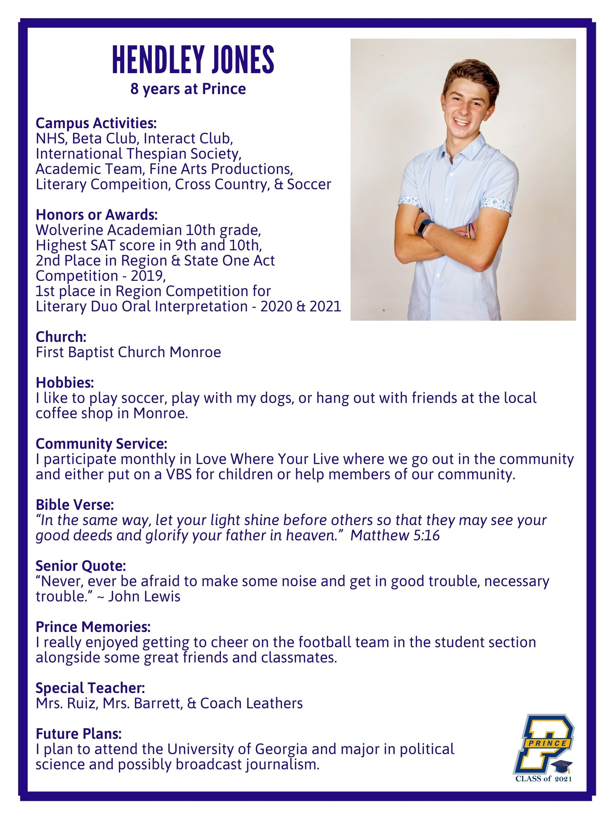
Senior spotlight
The Marketing Department will highlight each senior on the school’s social media accounts during Spring Semester 2022
  We will send a short questionnaire
  We encourage all to participate
  We will use the casual senior portrait

Slide 42
It’s a great day to be a Wolverine!
End of Presentation

